Slide 1
Preliminary research questions
RQ1: How are mock definition levels distributed across Apache projects, and what does this reveal about the structural maturity of mocking practices?
RQ2: How does the structural maturity of mock usage evolve over time within Apache projects, and what types of temporal trends characterize this evolution (increasing, decreasing, stable, or fluctuating)?
RQ3: How do different mock pattern levels correlate with the CCTR(complexity of test cases)?

Slide 2
Mock Level Reconstruction (L1 / L2 → L0)
Why reconstruct L1/L2 → L0
Directly comparing L0 and L1/L2 is unfair: one L0 mock belongs to one test, but one L1/L2 mock is shared across many tests.
So we reconstruct shared mocks into independent ones to make comparison unit-consistent.

Slide 3
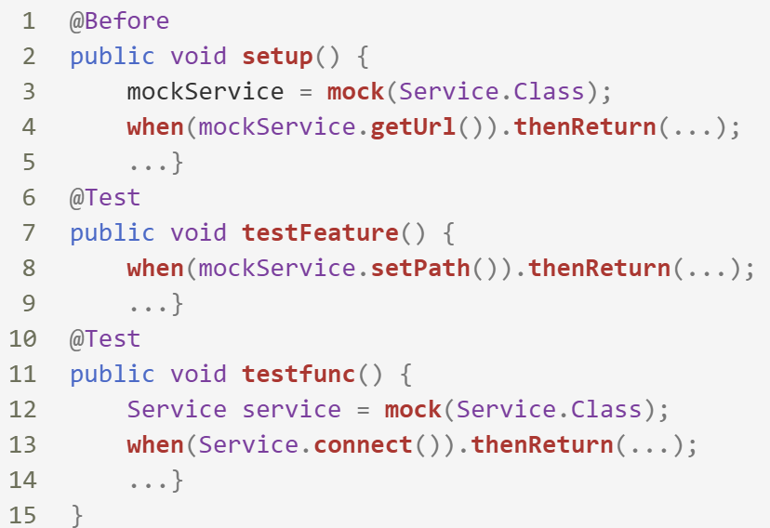
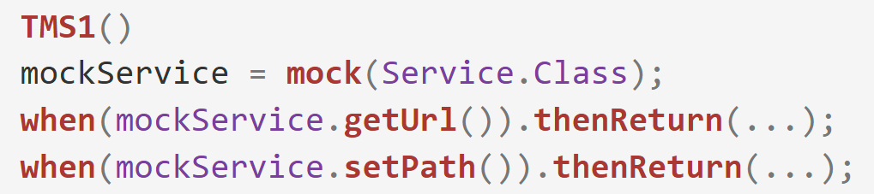
Mock Level Reconstruction (L1 / L2 → L0)
How We Reconstruct L1/L2 → L0
Recover by merging shared and test-specific stubs within each Test-Specific Mock Sequence (TMS).
Recover Test-Specific Mock Sequence per test case

Slide 4
Mock Level Reconstruction (L0 → L1 / L2 )
URL originUrl;
@BeforeaEach
void setup(){
originUrl = mock(URL.class);
when(url.getServiceKey()).thenReturn("Test");
when(url.getParameter(any())).thenReturn(“1");
}
public void test1() { URL url = mock(URL.class); Invoke newinvoke=new Invoke(url); when(url.getServiceKey()).thenReturn("Test");
when(url.getParameter(any()))).thenReturn("1");
String path=invoke.getPath(originUrl); assertNotNull(path);
}
Refactoring
public void test1() { String path=invoke.getPath(originUrl); assertNotNull(path); }
public void test2() {
originUrl = mock(URL.class);
String parameter = "testParameter";
when(originUrl.getParameter(any())))
.thenReturn("1"); Invoke invoke=new Invoke(originUrl);
String key = "key1";
when(originUrl.getServiceKey()).thenReturn(“Test"); invoke.verifyServiceKey(); verify(originUrl).getServiceKey();}
Refactoring
public void test2() { Invoke invoke=new Invoke(originUrl); invoke.verifyServiceKey(); verify(originUrl).getServiceKey(); }
level 0
level 1/2

Slide 5
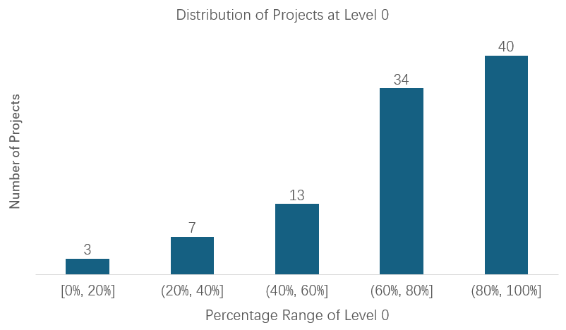
RQ1 — Distribution of Projects at Level 0

Slide 6
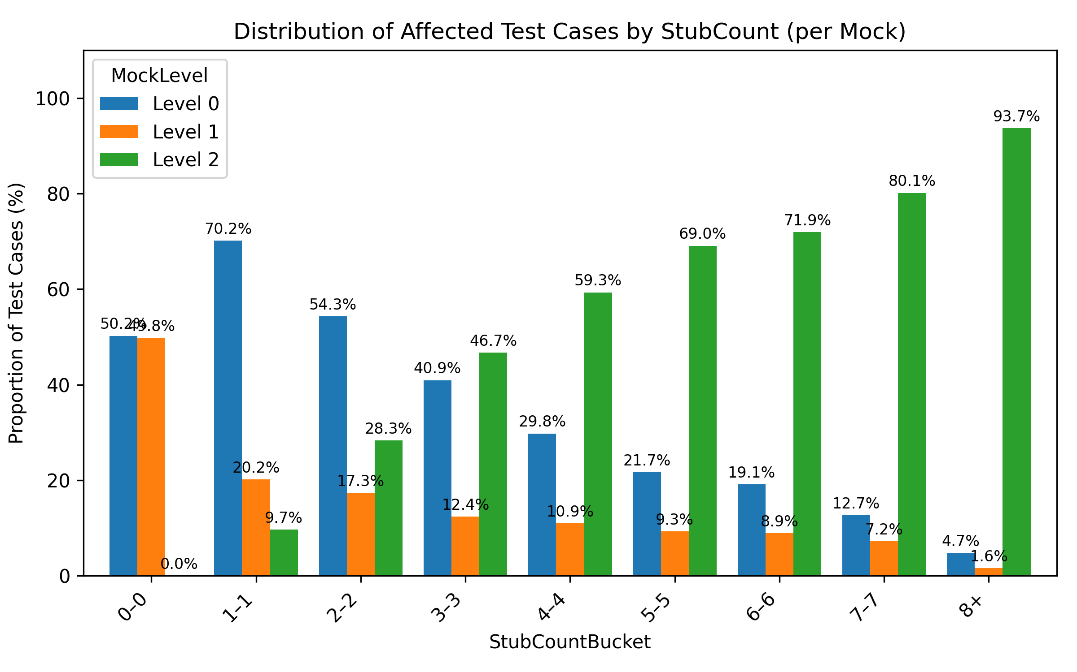
Distribution of Mocks by Stub Count

Slide 7
RQ3: How do different mock pattern levels correlate with the CCTR(complexity of test cases)?

Slide 8
CCTR_Level_Summary
MockLevel | MockObjectCount | TotalTestCount | AvgTestPerMock | CCTR Impact per Test | CCTR Impact per Test Suit
0 | 43048 | 43048 | 1.00 | 4.58 | 4.58
1 | 9718 | 24885 | 2.56 | 1.73 | 4.30
2 | 6681 | 32004 | 4.79 | 3.85 | 16.39

Slide 9
CCTR_Conversion_Group_Summary
ConvertedFrom | ConvertedTo | ConversionCount | TotalBeforeMocks | TotalAfterMocks | AvgBeforeCount | AvgAfterCount | AvgCCTRChange | AvgCCTRChangePerTest
0 | 1 | 5337 | 20405 | 5337 | 3.82 | 1.00 | -8.88 | -2.37
0 | 2 | 2173 | 13794 | 2173 | 6.35 | 1.00 | -18.61 | -3.26
1 | 0 | 9718 | 9718 | 24885 | 1 | 2.56 | 3.54 | 1.07
2 | 0 | 6681 | 6681 | 32004 | 1 | 4.79 | 84.22 | 6.41

